Slide 1
How to talk to SUMO through python API
Wushuang Bai
2022 06 16

Slide 2
The purpose of this presentation is to demonstrate how to run SUMO simulation using python API through a simple example.

Slide 3
Please download the simulation files and script used in this tutorial using the links:
Simulation files can be found here: https://pennstateoffice365.sharepoint.com/:f:/r/sites/IntelligentVehiclesandSystemsGroup-Active/Shared%20Documents/IVSG/Projects/Active/2021-2024_PennDOT_ADS_ConstructionZones/12_SUMO_Simulation_Pretesting/Testing_Data/how%20to%20export%20SUMO%20simulation%20results?csf=1&web=1&e=x1Pk83
Script can be found here: https://github.com/ivsg-psu/TrafficSimulators_GettingStartedWithDifferrentSimulators_GettingStartedWithSUMO/tree/main/Code
For more information, please see https://sumo.dlr.de/docs/TraCI.html#examples

Slide 4
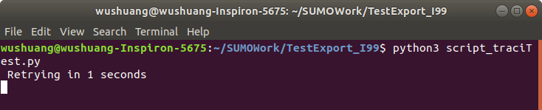
Step 1. Run the script script_traciTest.py using command "python3 script_traciTest.py".

Slide 5
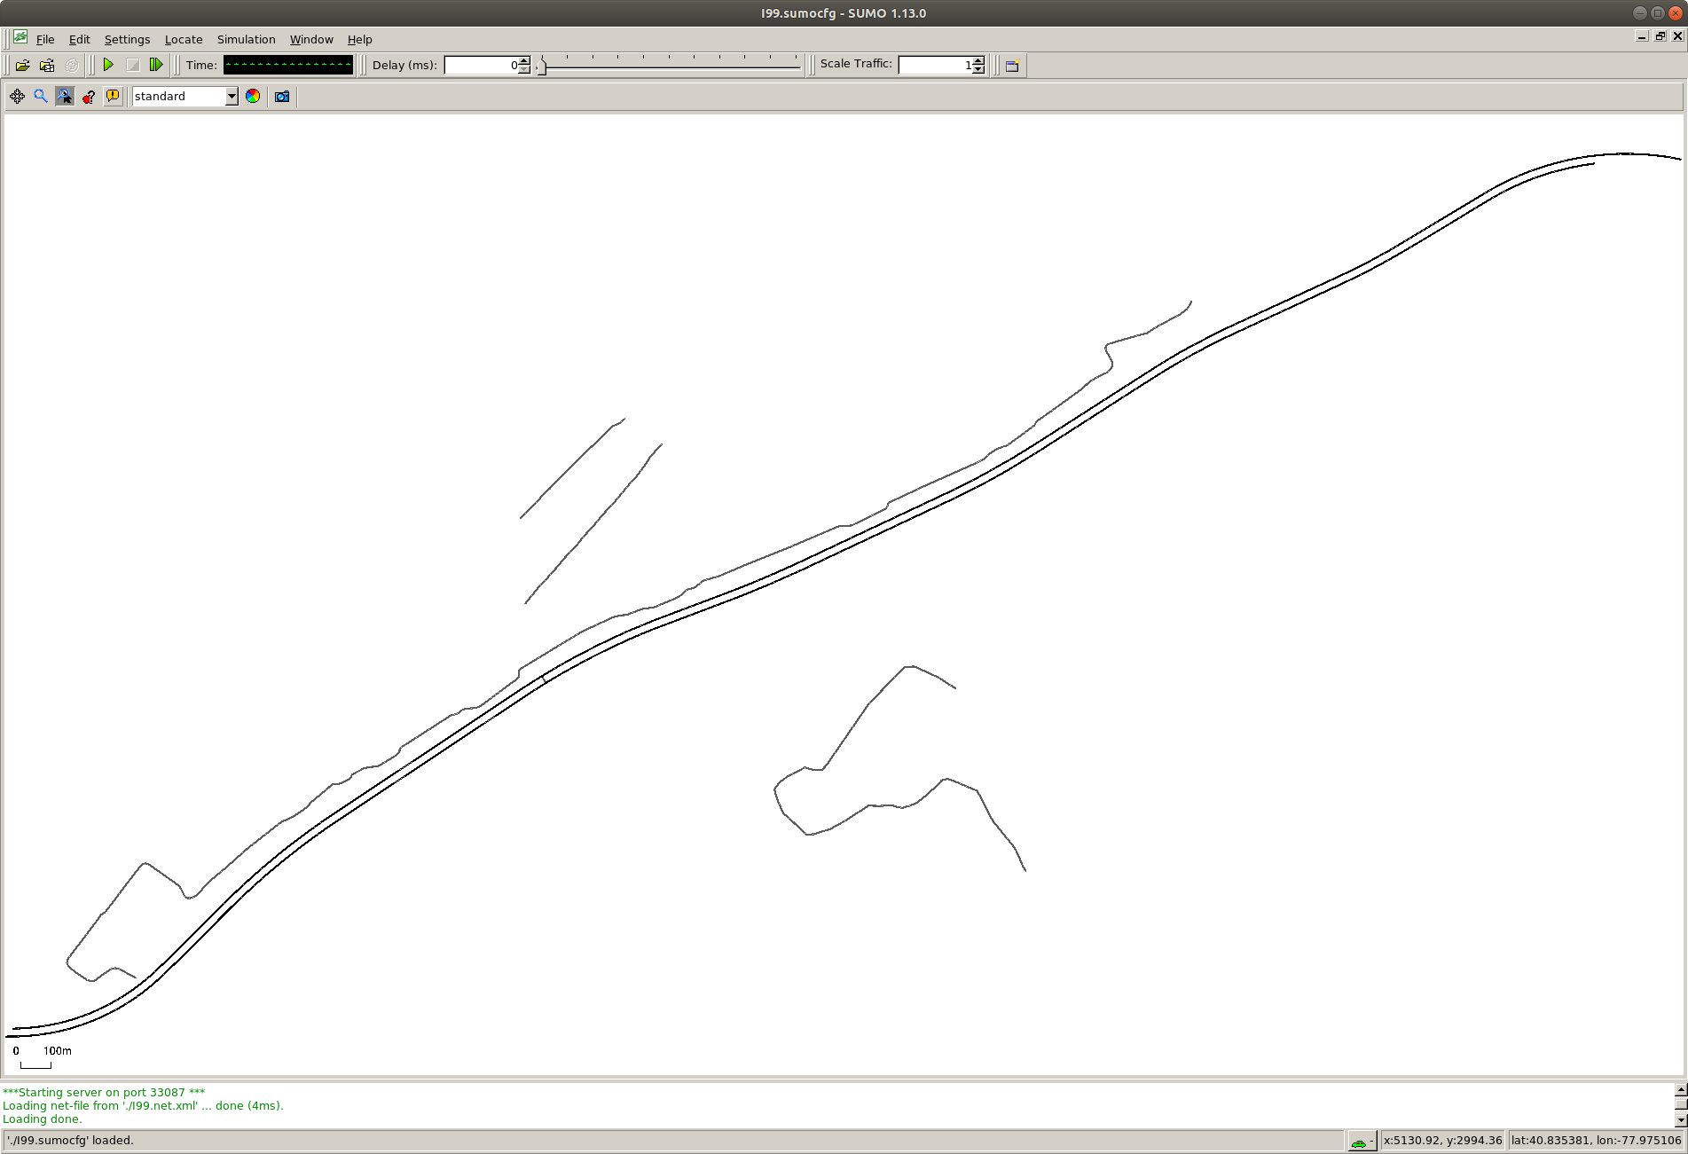
Step 2. SUMO gui pops up.

Slide 6
Step 3. Click on play button to start the simulation.

Slide 7
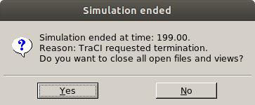
Step 4. Once the simulation ends as controlled by the script, window pops up indicating simulation ends.

Slide 8
Placeholder for another example of reading out SUMO data live. This will be the foundation of integrating SUMO with ROS.

